Slide 1
UID
Harsimrat Sudeep

Slide 2
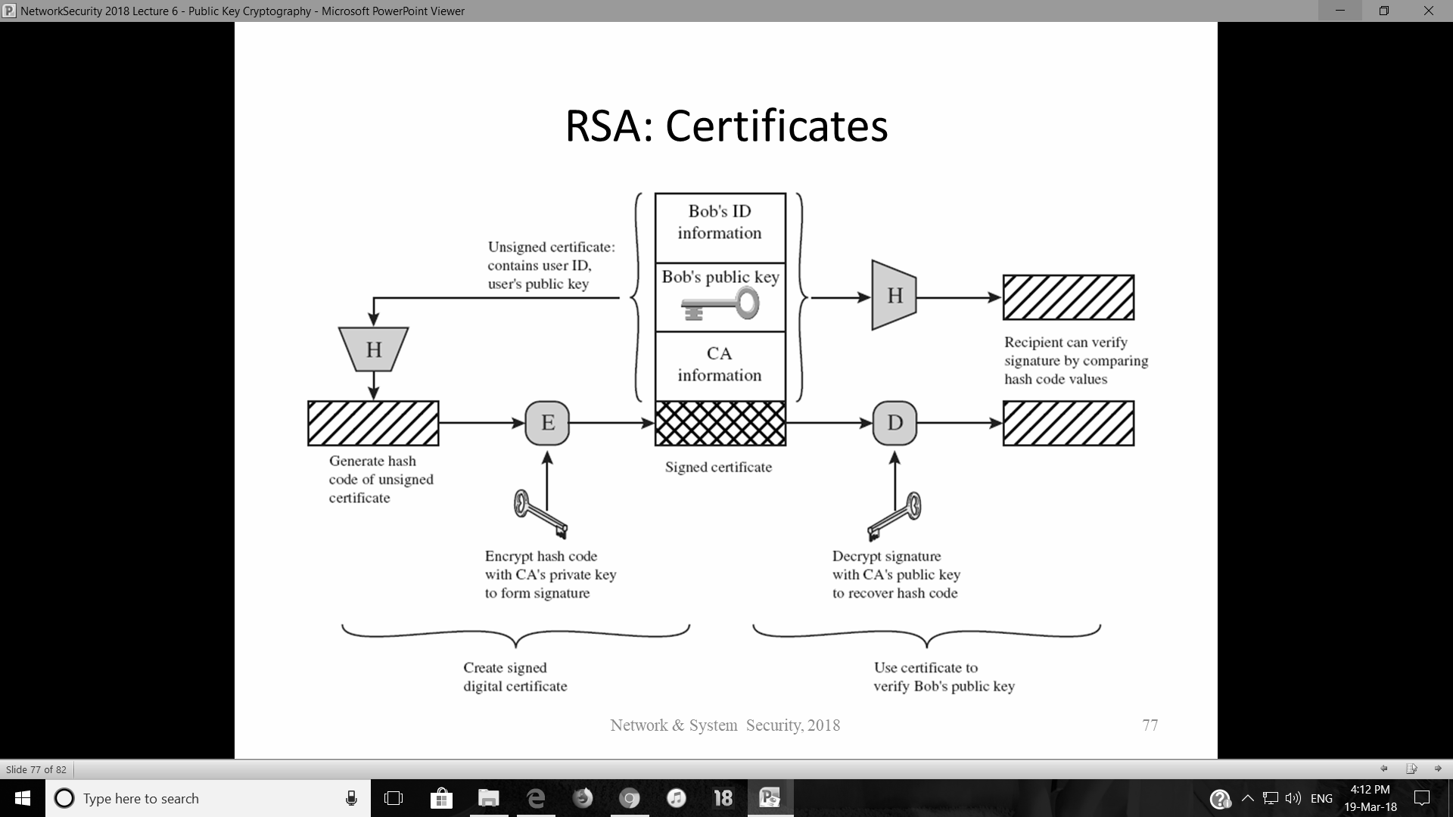

Slide 3
UID
Confidentiality
Ensured as we uses asymmetric key cryptography
Authentication
No need as server is open to all

Slide 4
UID
Message Integrity
Ensured as we use certificate with digital signature
Non-repudiation
Does not matter

Slide 5
Solution to Problems
Ensure secure communication
Server sends certificate to client so no one can change it
Response related to which question
We sends encrypted hash of question with our answer

Slide 6
Solution to Problems
Digital Signatures
Used in certificates to verify them
Access to “Public‐key Certificate”
certificate contains only the answer to the question and the hash of the question.

